Slide 1
Do you know WRC?
WRC = World Radiocommunication Conference
WRC = War of Radio frequency Competition
If there are no interferences in GMRT,
Radio astronomers are very happy.
However, the Present is …
We shall know the Importance of
Frequency Protection
and Sharing of RA

Slide 2
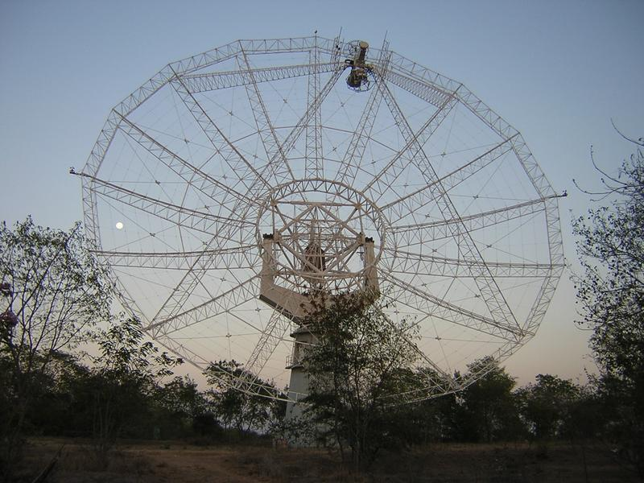
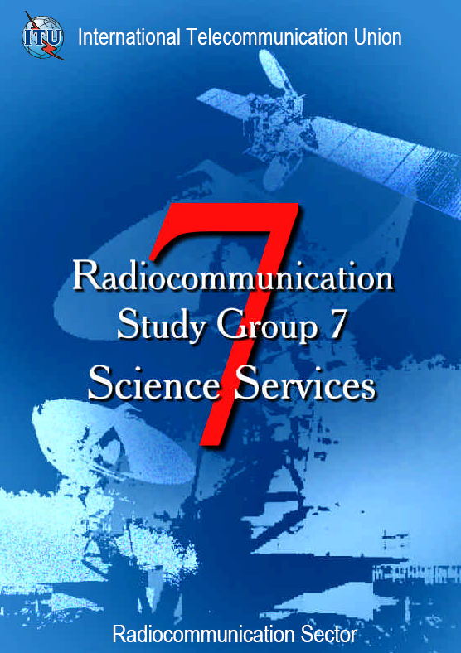



2008.02.14
HyunSoo Chung
KASI, KOREA

Slide 3
Questions?
WHY GMRT?
NO Questions, NO Spirit!!!

Slide 4
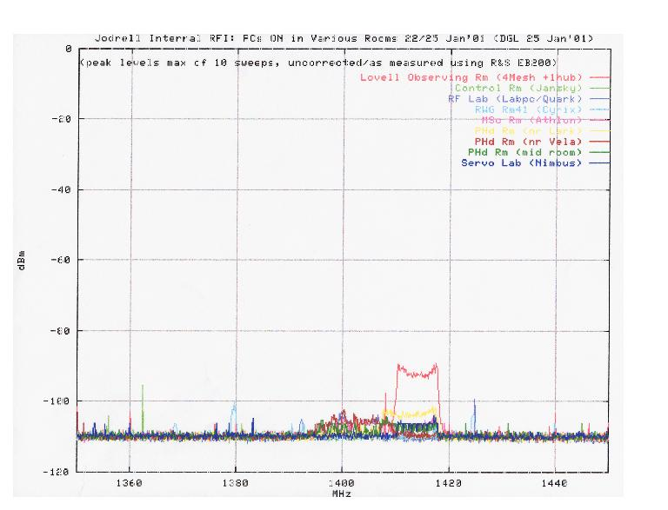
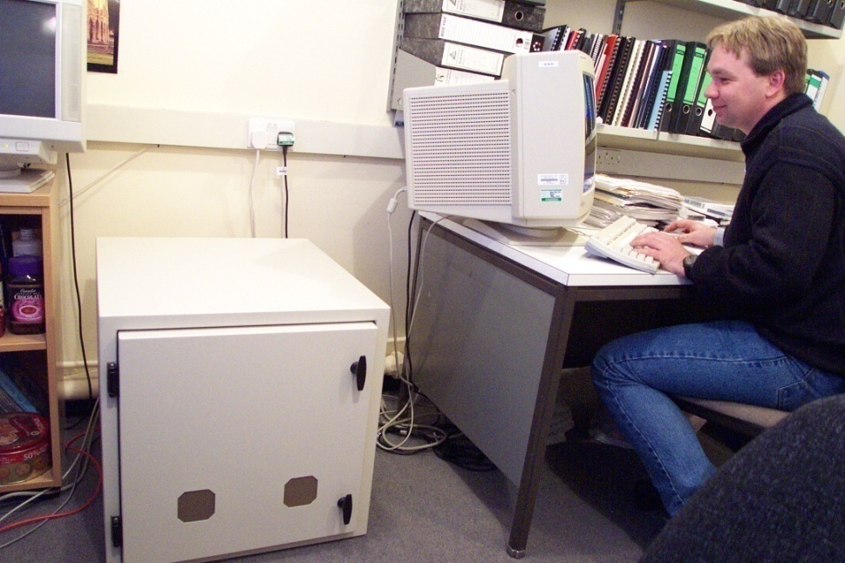
The enemy within
Computers, Cell Phone, modern electronics, …
PCs at 1420 MHz Shielded box 40dB

Slide 5
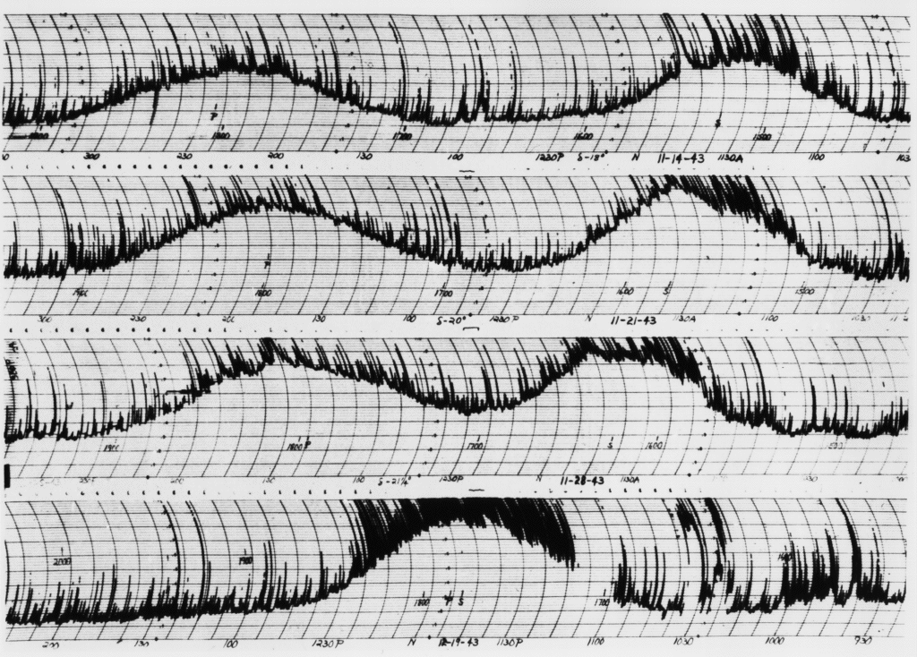
Interference is not new!

Slide 6
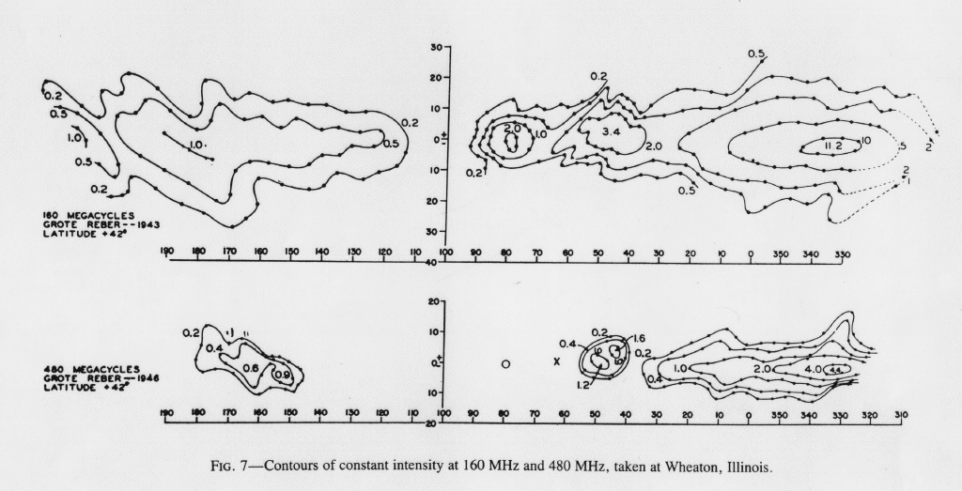
Interference may be manageable
Sporadic interference from car ignitions.
Drifting baselines due to receiver gain instability.
Milky Way signal has intermediate timescale.
IUCAF summer school, June 2005, Castel San Pietro
by Jim Cohen

Slide 7
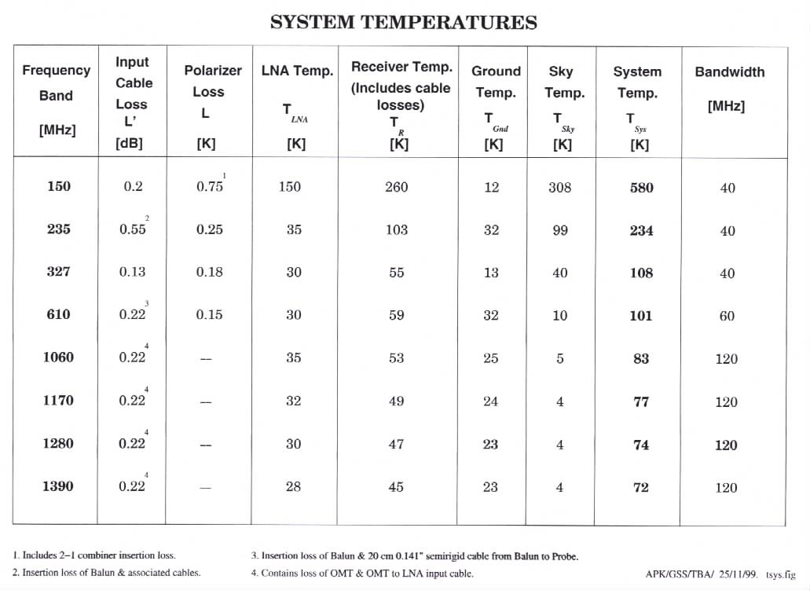
Using Frequencies of GMRT?

Slide 8
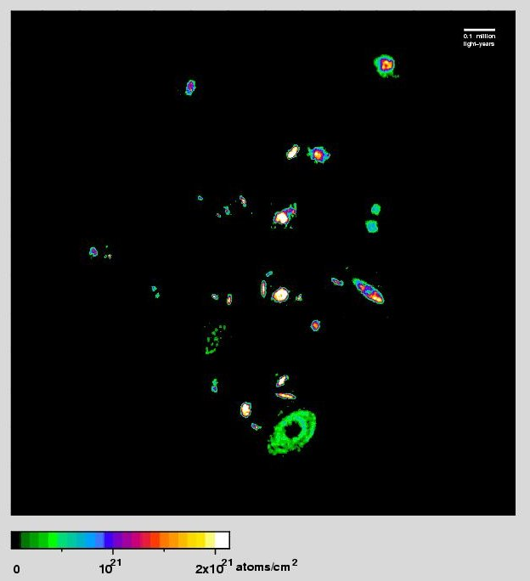
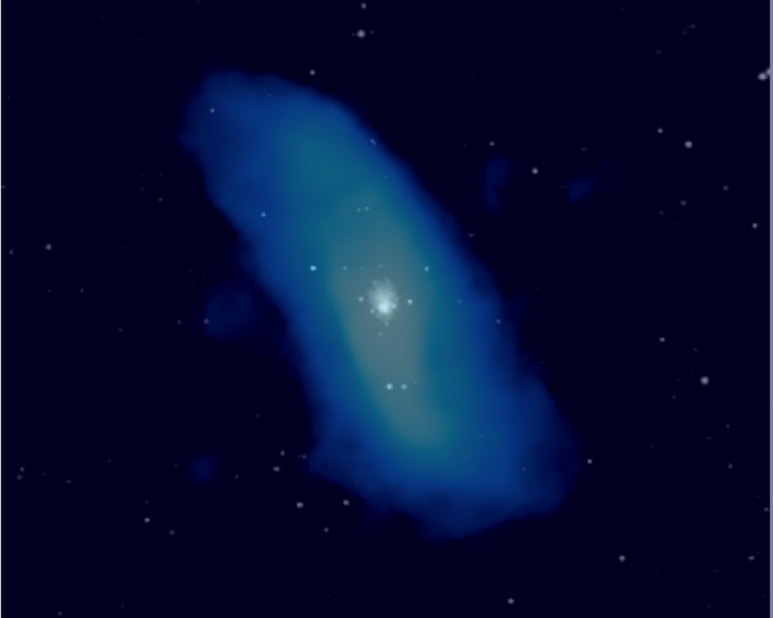
What’s the fequencies of GMRT?
150, 327, 610 MHz : Primary Allocation
1060, 1170, 1280, 1390 MHz
; no RA allocations in Radio Regulations
Eridanus Group of Galaxies
A Dwarf Galaxy with a Giant HI Disk

Slide 9
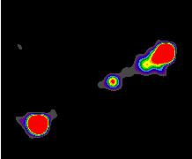
Is it really from harmful interference?
322-328.6 FIXED MOBILE RADIO ASTRONOMY 5.149
328.6-335.4 AERONAUTICAL RADIONAVIGATION 5.258 5.259
335.4-387 FIXED MOBILE 5.254
J1432+158: The Most Distant Giant Quasar at 333 MHz
5.259 Additional allocation: in Egypt, Israel,
Japan, and the Syrian Arab Republic, the band 328.6-335.4 MHz is also allocated to the mobile service on a secondary basis, subject to agreement obtained under No. 9.21. In order to ensure that harmful
interference is not caused to stations of the
aeronautical radionavigation service, stations of the mobile service shall not be introduced in the band
until it is no longer required for the aeronautical radionavigation service by any administration which may
be identified in the application of the procedure I
nvoked under No. 9.21. (WRC‑2000)

Slide 10
Soon no radio quiet zone on Earth
will be free from strong,
man-made signals
from the sky!!!

Slide 11
Radio Astronomers’
Interaction with the ITU-R
World
Radiocommunication
Conference
Radio Regulations (RR)
Questions
Regional
Radiocommunication
Conference
Radiocommunication
Assembly
Radio
Regulations
Board
Rules of
Procedure (ROP)
ITU-R
Recommendations
Radiocommunication
Advisory
Group
Study Groups
and Special
Committee
Conference
Preparatory
Meeting
CPM Report
Director
Radiocommunication
Bureau
IAP
SSD
SGD
TSD
Registration of
Radio Observatories

Slide 12
SG 7 structure
WP 7A
: Time signals and frequency standard emissions
WP 7B
: Space radio systems
WP 7C
: Earth-exploration satellite systems
and meteorological elements
WP 7D
: Radio Astronomy

Slide 13
ITU-R Recommendation Series
BO Satellite Delivery
BR Recording for production, archival and play-out; film for
television
BS Broadcasting service (sound)
BT Broadcasting service (television)
F Fixed service
M Mobile, radiodetermination, amateur and related satellite
services
P Radiowave propagation
RA Radio astronomy (WP7D)
RS Remote sensing systems (WP7B)
S Fixed satellite service
SA Space applications and meteorology (WP7C)
SF Frequency sharing and coordination between fixed satellite
and fixed service systems
SM Spectrum management
SNG Satellite news gathering
TF Time signals and frequency standards emissions (WP7A)
V Vocabulary and related subjects

Slide 14
ITU-R Questions : WP7D, Radio astronomy
Number | Category | Group | Title
129-2/7 | (C2) | WP7B/WP7C/WP7D | Unwanted emissions radiated from and received by stations of the science services
145-2/7 | (S2) | WP7D | Technical factors involved in the protection of radioastronomical observations
146-2/7 | (S2) | WP7D | Criteria for evaluation of interference to radio astronomy
149-1/7 | (S2) | WP7D | Frequency utilization on the far side of the Moon
205/7 | (S2) | WP7D | Radio observations of pulsars Note - Suppressed on 19/10/07 (RA-07)
226/7 | (S2) | WP7D | Frequency sharing between the radio astronomy service and other services in bands above 70 GHz
230/7 | (S2) | WP7D | Protection and sharing criteria for radio astronomy measurements from space
235-1/7 | (S2) | WP7B/WP7C/WP7D | Technical and operational characteristics of applications of science services operating above 275 GHz
237/7 | (S2) | WP7D | Technical and operational factors relating to interference mitigation practices at radio astronomy stations
241/7 | (S2) | WP7D | Frequency bands and protection criteria for radio astronomy observations from space Note - Suppressed on 19/10/07 (RA-07)
242/7 | (S3) | WP7D | Radio quiet zones
ITU-R Questions
 | RSS Feed
Number | Category | Group | Title
101-2/7 | (S3) | WP7A | Performance and reliability of frequency standards and their use in time-scales Note - Suppressed on 19/10/07 (RA-07)
102-2/7 | (S2) | WP7A | Terrestrial standard-frequency and time-signal dissemination Note - Suppressed on 19/10/07 (RA-07)
104-2/7 | (S3) | WP7A | Stability of standard-frequency and time-signal emissions as received Note - Suppressed on 19/10/07 (RA-07)
110-2/7 | (S2) | WP7A | Time codes
111-1/7 | (S2) | WP7A | Signal delays in antennas and other circuits and their calibration for high-accuracy time transfer
118-2/7 | (S2) | WP7B | Factors which affect frequency sharing between data relay satellite systems and systems of other services
129-2/7 | (C2) | WP7B/WP7C/WP7D | Unwanted emissions radiated from and received by stations of the science services
139-3/7 | (S2) | WP7B | Data transmission for Earth exploration-satellite systems
141-3/7 | (S2) | WP7B | Data transmission for meteorological satellite systems
145-2/7 | (S2) | WP7D | Technical factors involved in the protection of radioastronomical observations
146-2/7 | (S2) | WP7D | Criteria for evaluation of interference to radio astronomy
149-1/7 | (S2) | WP7D | Frequency utilization on the far side of the Moon
152-2/7 | (S3) | WP7A | Standard frequencies and time signals from satellites
201-2/7 | (S2) | WP7A | Two-way time and frequency transfer through communication satellites Note - Suppressed on 19/10/07 (RA-07)
202-1/7 | (S2) | WP7B | Protection criteria and frequency sharing between space very long baseline interferometry and other space research systems
203-1/7 | (S2) | WP7B | Characteristics and telecommunication requirements for space very long baseline interferometry
205/7 | (S2) | WP7D | Radio observations of pulsars Note - Suppressed on 19/10/07 (RA-07)
206-1/7 | (S2) | WP7A | Frequency comparisons of remotely located standards at the 10-15 level of uncertainty Note - Suppressed on 19/10/07 (RA-07)
207-2/7 | (S2) | WP7A | Time and frequency transfer using digital communication links
211/7 | (C2) | WP7B | Frequency sharing between the space research service and other services in the 37-38 GHz and 40-40.5 GHz bands
213-1/7 | (C1) | WP7C | Compatibility of spaceborne active sensors and systems in the services allocated above the band 5 250-5 460 MHz Note - Suppressed on 19/10/07 (RA-07)
215-1/7 | (C2) | WP7C | Frequency sharing between Earth exploration-satellite systems (passive), space research systems (passive) and systems in the fixed, mobile and fixed-satellite services in the band 18.6-18.8 GHz Note - Suppressed on 19/10/07 (RA-07)
218-1/7 | (S2) | WP7C | Frequency sharing between active sensor systems in the Earth exploration-satellite service and systems operating in other services at around 440 MHz and 5 300 MHz Note - Suppressed on 19/10/07 (RA-07)
219/7 | (C1) | WP7B | Space operation and space research services frequency bands for telecommand links in the range 100 MHz to 1 GHz Note - Suppressed on 19/10/07 (RA-07)
221/7 | (S2) | WP7B | Preferred frequency bands and protection criteria for space research service observations (passive)
222-1/7 | (S2) | WP7B | Radio links between earth stations and lunar and planetary missions by means of lunar and/or planetary data relay satellites
223/7 | (S2) | WP7A | The role of differential GPS networks in timing applications
224/7 | (S3) | WP7A | Algorithms for ensemble time scales and measurement systems Note - Suppressed on 19/10/07 (RA-07)
226/7 | (S2) | WP7D | Frequency sharing between the radio astronomy service and other services in bands above 70 GHz
229/7 | (C2) | WP7C | Frequency sharing between the Earth exploration-satellite service (passive) and airborne altimeters in the aeronautical radionavigation service in the band 4 200-4 400 MHz
230/7 | (S2) | WP7D | Protection and sharing criteria for radio astronomy measurements from space
231/7 | (S2) | WP7C | Earth exploration-satellite service (active) and space research service (active) operating above 100 GHz
232-1/7 | (S2) | WP7C | Frequency sharing between spaceborne passive sensors and other services in the bands 10.60-10.68 GHz, 31.5-31.8 GHz and 36-37 GHz
233/7 | (S1) | WP7C | Sharing conditions between active sensor systems in the Earth exploration-satellite service and systems operating in other services around 35.5-36.0 GHz Note - Suppressed on 19/10/07 (RA-07)
234/7 | (S2) | WP7C | Frequency sharing between active sensor systems in the Earth exploration-satellite service and systems operating in other services in the 1 215-1 300 MHz band
235-1/7 | (S2) | WP7B/WP7C/WP7D | Technical and operational characteristics of applications of science services operating above 275 GHz
236/7 | (S2) | WP7A | The future of the UTC time scale
237/7 | (S2) | WP7D | Technical and operational factors relating to interference mitigation practices at radio astronomy stations
238/7 | (S2) | WP7A | Trusted time source for time stamp authority
239/7 | (S2) | WP7A | Instrumentation time codes
240/7 | (S1) | WP7B | Necessary criteria and calculation method for establishing coordination requirements relating to space research and Earth exploration-satellite applications in a space-to-space network composed of a space station on a geostationary satellite and a space station on a non-geostationary satellite in the bands 22.55-23.55 GHz and 25.25-27.5 GHz Note - Suppressed on 19/10/07 (RA-07)
241/7 | (S2) | WP7D | Frequency bands and protection criteria for radio astronomy observations from space Note - Suppressed on 19/10/07 (RA-07)
242/7 | (S3) | WP7D | Radio quiet zones
243/7 | (S1) | WP7C | Characterization of technical parameters and interference effects and possible interference mitigation techniques for passive sensors operating in the Earth exploration-satellite service (passive)
244/7 | (S1) | WP7A | Interference between standard frequency and time signal services operating between 20 and 90 kHz
245/7 | (S2) | WP7A | Interference to the standard frequency and time signal service in the low-frequency band caused by noise from electrical sources

Slide 15
ITU-R Questions : WP7D, Radio astronomy
Number | Category | Group | Title
147/7 | (S2) | WP7D | Radioastronomy in the vicinity of the L2 Sun-Earth Lagrangian point Note - Suppressed on RA-00
227/7 | (C2) | WP7D | pERCENTAGE OF TIME FOR WHICH INTERFERENCE HARMFUL TO THE RADIO ASTRONOMY SERVICE CAN BE ACCEPTED Note - Suppressed on RA-00
ITU-R Questions
 | RSS Feed
Number | Category | Group | Title
101-2/7 | (S3) | WP7A | Performance and reliability of frequency standards and their use in time-scales Note - Suppressed on 19/10/07 (RA-07)
102-2/7 | (S2) | WP7A | Terrestrial standard-frequency and time-signal dissemination Note - Suppressed on 19/10/07 (RA-07)
104-2/7 | (S3) | WP7A | Stability of standard-frequency and time-signal emissions as received Note - Suppressed on 19/10/07 (RA-07)
110-2/7 | (S2) | WP7A | Time codes
111-1/7 | (S2) | WP7A | Signal delays in antennas and other circuits and their calibration for high-accuracy time transfer
118-2/7 | (S2) | WP7B | Factors which affect frequency sharing between data relay satellite systems and systems of other services
129-2/7 | (C2) | WP7B/WP7C/WP7D | Unwanted emissions radiated from and received by stations of the science services
139-3/7 | (S2) | WP7B | Data transmission for Earth exploration-satellite systems
141-3/7 | (S2) | WP7B | Data transmission for meteorological satellite systems
145-2/7 | (S2) | WP7D | Technical factors involved in the protection of radioastronomical observations
146-2/7 | (S2) | WP7D | Criteria for evaluation of interference to radio astronomy
149-1/7 | (S2) | WP7D | Frequency utilization on the far side of the Moon
152-2/7 | (S3) | WP7A | Standard frequencies and time signals from satellites
201-2/7 | (S2) | WP7A | Two-way time and frequency transfer through communication satellites Note - Suppressed on 19/10/07 (RA-07)
202-1/7 | (S2) | WP7B | Protection criteria and frequency sharing between space very long baseline interferometry and other space research systems
203-1/7 | (S2) | WP7B | Characteristics and telecommunication requirements for space very long baseline interferometry
205/7 | (S2) | WP7D | Radio observations of pulsars Note - Suppressed on 19/10/07 (RA-07)
206-1/7 | (S2) | WP7A | Frequency comparisons of remotely located standards at the 10-15 level of uncertainty Note - Suppressed on 19/10/07 (RA-07)
207-2/7 | (S2) | WP7A | Time and frequency transfer using digital communication links
211/7 | (C2) | WP7B | Frequency sharing between the space research service and other services in the 37-38 GHz and 40-40.5 GHz bands
213-1/7 | (C1) | WP7C | Compatibility of spaceborne active sensors and systems in the services allocated above the band 5 250-5 460 MHz Note - Suppressed on 19/10/07 (RA-07)
215-1/7 | (C2) | WP7C | Frequency sharing between Earth exploration-satellite systems (passive), space research systems (passive) and systems in the fixed, mobile and fixed-satellite services in the band 18.6-18.8 GHz Note - Suppressed on 19/10/07 (RA-07)
218-1/7 | (S2) | WP7C | Frequency sharing between active sensor systems in the Earth exploration-satellite service and systems operating in other services at around 440 MHz and 5 300 MHz Note - Suppressed on 19/10/07 (RA-07)
219/7 | (C1) | WP7B | Space operation and space research services frequency bands for telecommand links in the range 100 MHz to 1 GHz Note - Suppressed on 19/10/07 (RA-07)
221/7 | (S2) | WP7B | Preferred frequency bands and protection criteria for space research service observations (passive)
222-1/7 | (S2) | WP7B | Radio links between earth stations and lunar and planetary missions by means of lunar and/or planetary data relay satellites
223/7 | (S2) | WP7A | The role of differential GPS networks in timing applications
224/7 | (S3) | WP7A | Algorithms for ensemble time scales and measurement systems Note - Suppressed on 19/10/07 (RA-07)
226/7 | (S2) | WP7D | Frequency sharing between the radio astronomy service and other services in bands above 70 GHz
229/7 | (C2) | WP7C | Frequency sharing between the Earth exploration-satellite service (passive) and airborne altimeters in the aeronautical radionavigation service in the band 4 200-4 400 MHz
230/7 | (S2) | WP7D | Protection and sharing criteria for radio astronomy measurements from space
231/7 | (S2) | WP7C | Earth exploration-satellite service (active) and space research service (active) operating above 100 GHz
232-1/7 | (S2) | WP7C | Frequency sharing between spaceborne passive sensors and other services in the bands 10.60-10.68 GHz, 31.5-31.8 GHz and 36-37 GHz
233/7 | (S1) | WP7C | Sharing conditions between active sensor systems in the Earth exploration-satellite service and systems operating in other services around 35.5-36.0 GHz Note - Suppressed on 19/10/07 (RA-07)
234/7 | (S2) | WP7C | Frequency sharing between active sensor systems in the Earth exploration-satellite service and systems operating in other services in the 1 215-1 300 MHz band
235-1/7 | (S2) | WP7B/WP7C/WP7D | Technical and operational characteristics of applications of science services operating above 275 GHz
236/7 | (S2) | WP7A | The future of the UTC time scale
237/7 | (S2) | WP7D | Technical and operational factors relating to interference mitigation practices at radio astronomy stations
238/7 | (S2) | WP7A | Trusted time source for time stamp authority
239/7 | (S2) | WP7A | Instrumentation time codes
240/7 | (S1) | WP7B | Necessary criteria and calculation method for establishing coordination requirements relating to space research and Earth exploration-satellite applications in a space-to-space network composed of a space station on a geostationary satellite and a space station on a non-geostationary satellite in the bands 22.55-23.55 GHz and 25.25-27.5 GHz Note - Suppressed on 19/10/07 (RA-07)
241/7 | (S2) | WP7D | Frequency bands and protection criteria for radio astronomy observations from space Note - Suppressed on 19/10/07 (RA-07)
242/7 | (S3) | WP7D | Radio quiet zones
243/7 | (S1) | WP7C | Characterization of technical parameters and interference effects and possible interference mitigation techniques for passive sensors operating in the Earth exploration-satellite service (passive)
244/7 | (S1) | WP7A | Interference between standard frequency and time signal services operating between 20 and 90 kHz
245/7 | (S2) | WP7A | Interference to the standard frequency and time signal service in the low-frequency band caused by noise from electrical sources
C: Conference-oriented Questions associated with work related to specific
preparations for, and decisions of, world and regional radiocommunication
conferences:
C1: very urgent and priority studies, required for the next World Radiocommunication
Conference;
C2: urgent studies, expected to be required for other radiocommunication conferences;
S: Questions which are intended to respond to:
– matters referred to the Radiocommunication Assembly by the Plenipotentiary Conference, any other conference, the Council, the Radio Regulations Board;
– advances in radiocommunication technology or spectrum management;
– changes in radio usage or operation:
S1: urgent studies which are intended to be completed within two years;
S2: important studies, necessary for the development of radiocommunications;
S3: required studies, expected to facilitate the development of radiocommunications;

Slide 16
ITU-R Questions & Recommendations
Number | Related ITU-R RA. Recommendations
129-2/7 | 1750
145-2/7 | 314, 517, 611, 769, 1031, 1237, 1272
146-2/7
147/7 (Note – Suppressed) | 1417
149-1/7 | 479
205/7 (Note – Suppressed)
226/7
227/7 (Note – Suppressed) | 1513
230/7
235-1/7 | 1630
237/7
241/7 (Note – Suppressed)
242/7
ITU-R Questions
 | RSS Feed
Number | Category | Group | Title
101-2/7 | (S3) | WP7A | Performance and reliability of frequency standards and their use in time-scales Note - Suppressed on 19/10/07 (RA-07)
102-2/7 | (S2) | WP7A | Terrestrial standard-frequency and time-signal dissemination Note - Suppressed on 19/10/07 (RA-07)
104-2/7 | (S3) | WP7A | Stability of standard-frequency and time-signal emissions as received Note - Suppressed on 19/10/07 (RA-07)
110-2/7 | (S2) | WP7A | Time codes
111-1/7 | (S2) | WP7A | Signal delays in antennas and other circuits and their calibration for high-accuracy time transfer
118-2/7 | (S2) | WP7B | Factors which affect frequency sharing between data relay satellite systems and systems of other services
129-2/7 | (C2) | WP7B/WP7C/WP7D | Unwanted emissions radiated from and received by stations of the science services
139-3/7 | (S2) | WP7B | Data transmission for Earth exploration-satellite systems
141-3/7 | (S2) | WP7B | Data transmission for meteorological satellite systems
145-2/7 | (S2) | WP7D | Technical factors involved in the protection of radioastronomical observations
146-2/7 | (S2) | WP7D | Criteria for evaluation of interference to radio astronomy
149-1/7 | (S2) | WP7D | Frequency utilization on the far side of the Moon
152-2/7 | (S3) | WP7A | Standard frequencies and time signals from satellites
201-2/7 | (S2) | WP7A | Two-way time and frequency transfer through communication satellites Note - Suppressed on 19/10/07 (RA-07)
202-1/7 | (S2) | WP7B | Protection criteria and frequency sharing between space very long baseline interferometry and other space research systems
203-1/7 | (S2) | WP7B | Characteristics and telecommunication requirements for space very long baseline interferometry
205/7 | (S2) | WP7D | Radio observations of pulsars Note - Suppressed on 19/10/07 (RA-07)
206-1/7 | (S2) | WP7A | Frequency comparisons of remotely located standards at the 10-15 level of uncertainty Note - Suppressed on 19/10/07 (RA-07)
207-2/7 | (S2) | WP7A | Time and frequency transfer using digital communication links
211/7 | (C2) | WP7B | Frequency sharing between the space research service and other services in the 37-38 GHz and 40-40.5 GHz bands
213-1/7 | (C1) | WP7C | Compatibility of spaceborne active sensors and systems in the services allocated above the band 5 250-5 460 MHz Note - Suppressed on 19/10/07 (RA-07)
215-1/7 | (C2) | WP7C | Frequency sharing between Earth exploration-satellite systems (passive), space research systems (passive) and systems in the fixed, mobile and fixed-satellite services in the band 18.6-18.8 GHz Note - Suppressed on 19/10/07 (RA-07)
218-1/7 | (S2) | WP7C | Frequency sharing between active sensor systems in the Earth exploration-satellite service and systems operating in other services at around 440 MHz and 5 300 MHz Note - Suppressed on 19/10/07 (RA-07)
219/7 | (C1) | WP7B | Space operation and space research services frequency bands for telecommand links in the range 100 MHz to 1 GHz Note - Suppressed on 19/10/07 (RA-07)
221/7 | (S2) | WP7B | Preferred frequency bands and protection criteria for space research service observations (passive)
222-1/7 | (S2) | WP7B | Radio links between earth stations and lunar and planetary missions by means of lunar and/or planetary data relay satellites
223/7 | (S2) | WP7A | The role of differential GPS networks in timing applications
224/7 | (S3) | WP7A | Algorithms for ensemble time scales and measurement systems Note - Suppressed on 19/10/07 (RA-07)
226/7 | (S2) | WP7D | Frequency sharing between the radio astronomy service and other services in bands above 70 GHz
229/7 | (C2) | WP7C | Frequency sharing between the Earth exploration-satellite service (passive) and airborne altimeters in the aeronautical radionavigation service in the band 4 200-4 400 MHz
230/7 | (S2) | WP7D | Protection and sharing criteria for radio astronomy measurements from space
231/7 | (S2) | WP7C | Earth exploration-satellite service (active) and space research service (active) operating above 100 GHz
232-1/7 | (S2) | WP7C | Frequency sharing between spaceborne passive sensors and other services in the bands 10.60-10.68 GHz, 31.5-31.8 GHz and 36-37 GHz
233/7 | (S1) | WP7C | Sharing conditions between active sensor systems in the Earth exploration-satellite service and systems operating in other services around 35.5-36.0 GHz Note - Suppressed on 19/10/07 (RA-07)
234/7 | (S2) | WP7C | Frequency sharing between active sensor systems in the Earth exploration-satellite service and systems operating in other services in the 1 215-1 300 MHz band
235-1/7 | (S2) | WP7B/WP7C/WP7D | Technical and operational characteristics of applications of science services operating above 275 GHz
236/7 | (S2) | WP7A | The future of the UTC time scale
237/7 | (S2) | WP7D | Technical and operational factors relating to interference mitigation practices at radio astronomy stations
238/7 | (S2) | WP7A | Trusted time source for time stamp authority
239/7 | (S2) | WP7A | Instrumentation time codes
240/7 | (S1) | WP7B | Necessary criteria and calculation method for establishing coordination requirements relating to space research and Earth exploration-satellite applications in a space-to-space network composed of a space station on a geostationary satellite and a space station on a non-geostationary satellite in the bands 22.55-23.55 GHz and 25.25-27.5 GHz Note - Suppressed on 19/10/07 (RA-07)
241/7 | (S2) | WP7D | Frequency bands and protection criteria for radio astronomy observations from space Note - Suppressed on 19/10/07 (RA-07)
242/7 | (S3) | WP7D | Radio quiet zones
243/7 | (S1) | WP7C | Characterization of technical parameters and interference effects and possible interference mitigation techniques for passive sensors operating in the Earth exploration-satellite service (passive)
244/7 | (S1) | WP7A | Interference between standard frequency and time signal services operating between 20 and 90 kHz
245/7 | (S2) | WP7A | Interference to the standard frequency and time signal service in the low-frequency band caused by noise from electrical sources

Slide 17
ITU-R Recommendations : Radio astronomy
RA.314 | Preferred frequency bands for radio astronomical measurements
RA.479 | Protection of frequencies for radioastronomical measurements in the shielded zone of the Moon
RA.517 | Protection of the radio astronomy service from transmitters operating in adjacent bands
RA.611 | Protection of the radio astronomy service from spurious emissions
RA.769 | Protection criteria used for radio astronomical measurements
RA.1031 | Protection of the radio astronomy service in frequency bands shared with other services
RA.1237 | Protection of the radio astronomy service from unwanted emissions resulting from applications of wideband digital modulation
RA.1272 | Protection of radio astronomy measurements above 60 GHz from ground based interference
RA.1417 | A radio-quiet zone in the vicinity of the L2 Sun-Earth Lagrange point
RA.1513 | Levels of data loss to radio astronomy observations and percentage-of-time criteria resulting from degradation by interference for frequency bands allocated to the radio astronomy on a primary basis
RA.1630 | Technical and operational characteristics of ground-based astronomy systems for use in sharing studies with active services between 10 THz and 1 000 THz
RA.1631 | Reference radio astronomy antenna pattern to be used for compatibility analyses between non-GSO systems and radio astronomy service stations based on the epfd concept
RA.1750 | Mutual planning between the Earth exploration-satellite service (active) and the radio astronomy service in the 94 GHz and 130 GHz bands

Slide 18
Rec. ITU-R | Title | Questions
RA.314-9 | Preferred frequency bands for radio astronomical measurements | 145-2/7
RA.479-5 | Protection of frequencies for radioastronomical measurements in the shielded zone of the Moon | 149-1/7
RA.517-3 | Protection of the radio astronomy services from transmitters operating in adjacent bands | 145-2/7
RA.611-3 | Protection of the radio astronomy service from spurious emissions | 145-2/7
RA.769-2 | Protection criteria used for radio astronomical measurements | 145-2/7
RA.1031-1 | Protection of the radio astronomy service in frequency bands shared with other services | 145-2/7
RA.1237-1 | Protection of the radio astronomy service from unwanted emissions resulting from applications of wideband digital modulation | 145-2/7
RA.1272-1 | Protection of radio astronomy measurements above 60 GHz from ground based interference | 145-2/7
RA.1417 | A radio-quiet zone in the vicinity of the L₂ Sun-Earth Lagrange point | 147/7
RA.1513-1 | Levels of data loss to radio astronomy observations and percentage-of-time criteria resulting from degradation by interference for frequency bands allocated to the radio astronomy on a primary basis | 227/7
RA.1630 | Technical and operational characteristics of ground-based astronomy systems for use in sharing studies with active services between 10 THz and 1 000 THz | 235/7
RA.1750 | Mutual planning between the EESS (active) and the RAS in the 94 GHz and 130 GHz bands | 129/7

Slide 19
ITU-R Recommendations in the Radio Astronomy Series (1)
Basic Protection Criteria
RA.314 Preferred frequency bands for radio astronomical measurements
RA.769 Protection criteria used for radio astronomical measurements
RA.1513 Levels of data loss to radio astronomy observations and percentage-of-time criteria resulting from degradation by interference for frequency bands allocated to radio astronomy on a primary basis
Coordination Zones
RA.1031 Protection of the radio astronomy service in frequency bands shared with other services
RA.1272 Protection of radio astronomy measurements above 60 GHz from ground based interference
Out-of-Band and Spurious transmissions
RA.517 Protection of the radio astronomy services from transmitters operating in adjacent bands
RA.611 Protection of the radio astronomy service from spurious emissions
RA.1237 Protection of the radio astronomy service from unwanted emissions resulting from applications of wideband digital modulation

Slide 20
ITU-R Recommendations in the Radio Astronomy Series (2)
Protection of regions in Space
RA.479 Protection of frequencies for radioastronomical measurements in the shielded zone of the Moon
RA.1417 A radio-quiet zone in the vicinity of the L2 Sun-Earth Lagrange point
Miscellaneous
RA.1631 Reference radio astronomy antenna pattern to be used for compatibility analyses between non-GSO systems and radio astronomy service stations based on the epfd concept
RA.1630 Technical and operational characteristics of ground-based astronomy systems for use in sharing studies with active services between 10 THz and 1000 THz

Slide 21
Criterion for Interference Threshold in Radio Astronomy
As applied in Recommendation RA.769, the detrimental threshold is the level of interference that introduces at the output of a receiver a change in amplitude (voltage) equal to 1/10 of the rms noise, in a total-power measurement. (CCIR Report 224-1, 1966).
A more general definition: The threshold level of detrimental interference is that which causes an increase of 10% in the uncertainty of the RA measurements.
Visualize the effect as:
Increasing the length of error bars by 10% in any measurement involving the power response,
Reducing the effective integration time by 20%.
To specify the threshold in terms of pfd or spfd of the interfering signal, we need to calculate the ratio of interference to noise at the receiver output.

Slide 22
ITU-R Questions : ITU-R 129-2/7
Unwanted emissions radiated from and received by stations of the science services
(1990-1993-2003)
The ITU Radiocommunication Assembly,
considering
a) that the radiation of unwanted emissions by space stations or earth stations of the science services could cause
interference to other services;
b) that the radiation of unwanted emissions by other services could cause interference to space stations and earth stations of the science services;
c) that the various radio services differ greatly in the sensitivity of their stations to interference;
d) that the specification of acceptable levels of unwanted emissions must take into account the practical aspects of
achieving these levels;
e) that limitations on the level of unwanted emissions should take into account the probability of simultaneous
interference to a station from more than one interfering source;
that there is a need to adopt a standard technique for the measurement of unwanted emissions in order to determine
compliance with specified levels of these emissions,
noting
a) that Appendix 3 of the Radio Regulations specifies only the maximum permitted levels of spurious emissions for
transmitters of stations of the space services;
that Recommendation 66 (Rev.WRC-2000commends the ITU-R study the question of unwanted emissions resulting
from transmitters of all services and all modulation methods, and on this basis to develop recommendations for
maximum permitted levels of unwanted emissions,

Slide 23
ITU-R Questions : ITU-R 129-2/7
decides that the following Question should be studied
1 What limits, based upon practical considerations, should be placed upon the power of unwanted emissions
radiated by space and earth stations of the science services in order to protect other services?
2 What levels of unwanted emissions from stations of other services are acceptable at space and earth stations of the science services?
3 In what ways can radio astronomy and passive sensor observations be affected by unwanted emissions from
radio transmitters, and from other electrical equipment?
What techniques may be employed at space and earth stations of the science services to mitigate the effects of
unwanted emissions?
further decides
1 that the results of the above studies should be included in (a) Recommendation(s);
2 that the above studies should be completed by 2006.

Slide 24
ITU-R Questions : ITU-R 145-2/7
Technical factors involved in the protection of radio astronomical observations (1990-1993-2000)
The ITU Radiocommunication Assembly,
considering
a) that radio astronomy is based on the reception of natural emissions at much lower power levels than are generally used in other radio services, and may therefore suffer harmful interference at levels which could be tolerated by many
other services;
b) that, for an understanding of astronomical phenomena, radioastronomers must observe both at specific and immutable line frequencies and also in a series of bands throughout the continuum spectrum;
that existing measures to protect the radio astronomy service are based on the assumption that the radio astronomy
stations are located on Earth,
decides that the following Question should be studied
1 What are the preferred frequency bands for the radio astronomy service?
2 What are the characteristics of observational techniques in radio astronomy?
3 What are the factors which affect the practicability of frequency sharing between radio astronomy
and other radio services?
In what ways can radio astronomy observations be affected by spurious and out-of-band emissions
from radio transmitters located in other frequency bands and by other electrical equipment?
further decides
1 that the results of the above studies should be included in (a) Recommendation(s);
2 that the above studies should be completed by 2006.
NOTE 1 – Question ITU-R 230/7 deals with radio astronomy observations from space.

Slide 25
ITU-R Questions : ITU-R 146-2/7
Criteria for evaluation of interference to radio astronomy (1990-1993-2000)
The ITU Radiocommunication Assembly,
considering
a) that under the Radio Regulations (RR), frequency bands have been allocated to radio astronomy for both line and
continuum observations;
b) that harmful interference to radio astronomy observations may be caused by unwanted signals of very low power;
c) that other services operate in many of the bands in which radio astronomy has allocations, or use high-power
transmitters in bands adjacent to, or harmonically related to, those used for radio astronomy;
d) that the increasing number of transmissions from spacecraft may introduce problems of interference to radio
astronomy and that these cannot be avoided by choice of site for an observatory or by local protection;
e) that the use of orbiting antennas in radio astronomy, both as array elements and as independent radio telescopes,
offers advantages over terrestrial antennas for certain observations;
f) that in Recommendation 61*, the WARC-79 requests information relating to criteria for harmful interference to
radio astronomy;
that in Resolution 63, the WARC-79 invited the ITU-R to continue studies, relating to industrial, scientific and
medical (ISM) equipment, to ensure adequate protection of radiocommunication services,
* This Recommendation was suppressed by WRC-2000.

Slide 26
ITU-R Questions : ITU-R 146-2/7
decides that the following Question should be studied
1 What is the practical interpretation for the radio astronomy service, of harmful interference as defined in RR No. 1.169?
2 What are the threshold levels of unwanted signals which, if exceeded for more than specified percentages of time, will cause harmful interference, and what is the dependence of these thresholds on the
nature and methods of the radio astronomical observations?
3 What are the levels of interference which may occur at typical observatory sites, due to various
sources of interference, including:
3.1 transmissions of other services operating in the bands used for radio astronomy observations;
3.2 harmonics, intermodulation products, and sidebands from transmitters in other frequency bands;
3.3 other sources of electrical interference including ISM equipment?
4 What is the influence of reflections from aircraft and Earth satellites in increasing the risk of
interference?
5 What is the response of typical radio astronomy receivers to signals in frequency bands adjacent
to the nominal receiver acceptance band?
6 What special precautions may be necessary, on the part of radioastronomers and the operators of the
other services, when a transmitter which is a potential source of interference is on a spacecraft or
aircraft within the field of view of a radioastronomical observatory?
7 What are the conditions required to avoid harmful interference to observations involving radio
astronomy antennas?
further decides
1 that the results of the above studies should be included in (a) Recommendation(s);
2 that the above studies should be completed by 2006.
______________
** Propagation data for this study will be required from Radiocommunication Study Group 3.

Slide 27
ITU-R Questions : ITU-R 149-1/7
Frequency utilization on the far side of the Moon (1990-1993)
The ITU Radiocommunication Assembly,
considering
a) that some radioastronomical and other scientific experiments are difficult, and perhaps impossible, to carry out on the surface of the Earth by reason of tropospheric and ionospheric absorption and scintillation;
b) that the development of spacecraft will enable experiments to be carried out in the relatively quiet environment on the far side of the Moon;
c) that in addition to the establishment of line-of-sight communication links for scientific and other purposes between
the Earth and spacecraft, it may be necessary to establish links between stations on the far side of the Moon and other stations either on or visible from the Earth;
d) that on the far side of the Moon a great degree of isolation from terrestrial radiation is provided at all radio
frequencies;
e) that Nos. 22.22 – 22.25 of the Radio Regulations recognize the necessity of maintaining the shielded zone of the
Moon as an area of great potential for observations by the radio astronomy service and for passive space research and, consequently, as free as possible from transmissions;
that the optimum utilization of frequencies on the far side of the Moon requires better understanding of the shielding
effects due to the presence of the Moon,

Slide 28
ITU-R Questions : ITU-R 149-1/7
decides that the following Question should be studied
1 In what way does the shielding caused by the Moon vary, as a function of frequency, angular distance from the limb of the Moon towards the centre of the far side, and distance above the surface of the Moon?
2 What are the preferred means and routes for communicating between a station on the far side of the Moon and an earth station?
3 In what frequency bands would radioastronomical measurements have marked advantages as compared with
observations from the surface of the Earth, if carried out on the far side of the Moon?
What frequency protection criteria should be adopted for a station on the far side of the Moon?
further decides
1 that the results of the above studies should be included in (a) Recommendation(s);
2 that the above studies should be completed by 2006.

Slide 29
ITU-R Questions : ITU-R 205/7
Radio observations of pulsars (1993)
The ITU Radiocommunication Assembly,
considering
a) that radio observations of pulsars are important not only for astrophysical purposes, but also for the purpose of
precision timekeeping;
b) that the emissions received from pulsars are very weak, and that radio observations of pulsars are particularly
vulnerable to harmful interference;
c) that the mean power flux-density received from radio pulsars decreases with increasing frequency, and that the
galactic background emission also decreases with increasing frequency;
d) that the pulses are dispersed by propagation in the interstellar medium, and that this dispersion decreases as the square of the frequency;
e) that multipath scattering in the interstellar medium causes pulse broadening which decreases approximately as the
fourth power of the frequency;
f) that the most stable pulsars for timekeeping are those with millisecond periods, for which the effects described in
§ c), d) and e) cause the greatest observational difficulties;
g) that an increase in observing bandwidth can lead to improved sensitivity;
that many frequency bands allocated to the radio astronomy service are shared with active services which transmit
in the same frequency band,

Slide 30
ITU-R Questions : ITU-R 205/7
decides that the following Question should be studied
1 What are the preferred frequency bands for the observation of radio pulsars?
2 What are the threshold levels of unwanted signals, which if exceeded for more than specified percentages of time
will cause harmful interference to radio observations of pulsars?
3 What is the feasibility of frequency sharing between the radio astronomy service and other services, in the
particular case of radio observations of pulsars?
What are most appropriate pulsars for use in precision timekeeping?
further decides
1 that the results of the above studies should be included in (a) Recommendation(s);
2 that the above studies should be completed by 2006.

Slide 31
ITU-R Questions : ITU-R 226/7
Frequency sharing between the radio astronomy service and other services in bands
above 70 GHz (1997)
The ITU Radiocommunication Assembly,
considering
a) that a large number of atomic and molecular spectral lines are observed at frequencies above 70 GHz, and that many of these lines are of great importance to astronomy but only few fall within bands allocated to radio astronomy;
b) that these spectral lines along with continuum observations provide unique information about star formation,
including the formation of planets in other solar systems, the existence of pre‑biological molecules and
extra-terrestrial life, the physics and chemistry of the interstellar medium, the history of the universe, and about other astrophysical processes of great interest;
c) that Doppler-shifted lines of great interest for the study of the early universe have been detected at frequencies well
outside the bands allocated to radio astronomy;
d) that sharing between radio astronomy observatories and ground-based transmitters is facilitated in the mm-wave and
submm-wave spectral regions by topography, by the atmospheric absorption bands, and by the natural attenuation
provided by atmospheric gases;
e) that there are only a small number of mm-wave and submm-wave observatories operating worldwide;
f) that several large mm-wave and submm-wave telescopes, which will incorporate the most advanced technology, are
planned or are under construction, and that they represent large collaborative scientific investments by the participating countries;

Slide 32
ITU-R Questions : ITU-R 226/7
g) that mm-wave and submm-wave observatories are, wherever practicable, located in isolated remote sites, to take
maximum advantage of extremely dry atmospheric conditions and a low interference environment;
h) that geographical sharing between the radio astronomy service and other services may be feasible with the creation of protection zones by national administrations; and
that there is extensive development being carried out to provide radiocommunication services at mm-wavelengths,
e.g. for the transmission of large volumes of data, and for mass market devices such as vehicular radars,
decides that the following Question should be studied
1 What are the services with which the radio astronomy service can share frequency bands above 70 GHz?
What are the conditions for frequency sharing between radiocommunication services above 70 GHz
using active and passive systems?
further decides
1 that the results of the decides above should be the subject of a report to be prepared as a contribution to the Report of
the Conference Preparatory Meeting to the WRC‑07.

Slide 33
ITU-R Questions : ITU-R 227/7
Percentage of time for which interference harmful to the radio astronomy service
can be accept (1997)
The ITU Radiocomrmful to the munication Assembly,
Considering
a) that radio astronomy is an active area of research science which continues to add valuable knowledge to
astrophysics and to our understanding of the Universe;
b) that radio astronomy, in order to continue its progress, depends on access to the radio spectrum through allocated
frequency bands at the highest sensitivity and without interference;
c) that current and future instrumentation continues to be developed at many sites to improve the system sensitivity;
d) that the threshold levels of interference detrimental to the radio astronomy service, as given in Recommendation
ITU-R RA.769, are derived from representative technical and operational parameters of radio astronomical
observations and do not take into account explicitly the extreme weakness of sources observed,
the power flux-densities of which may be tens of dB below the threshold values;
e) that, for interference above these levels, resulting from unusual propagation conditions, a number of 10% for the
acceptable percentage of time, based on propagation models and climatic zone classifications approved by the ITU, has been used for some 20 years;
f) that coordination with other services based on this approach has led to long periods of time where observations were free from interference;
that in the past two decades, models of propagation of greatly improved accuracy have been developed, and radio
astronomy observing methods have become more sophisticated with increasingly severe time constraints;

Slide 34
ITU-R Questions : ITU-R 227/7
h) that, for interference by services with transmissions randomly distributed in time and sharing the frequency band with the radio astronomy service, or resulting from the spurious and out‑of-band emissions for a multiple assembly of
transmitters from one or more systems, no acceptable percentage of time has been established;
j) that the impact on radio astronomy observations depends inter alia on the temporal characteristics of the interference;
k) that Monte Carlo methods are currently being developed to determine the appropriate separation distances between
radio astronomy sites and an aggregate of mobile earth stations;
l) that these methods require the specification of an acceptable percentage of time during which
the aggregate interference is permitted to exceed threshold levels detrimental to the radio astronomy service,
decides that the following Question should be studied
1 What are acceptable percentages of time for which aggregate interference from sources of various temporal
characteristics may exceed levels of interference harmful to the radio astronomy service?
further decides
1 that the above studies should be completed by 2001.

Slide 35
ITU-R Questions : ITU-R 230/7
Protection and sharing criteria for radio astronomy measurements from space (2000)
The ITU Radiocommunication Assembly,
considering
a) that space-based radio telescopes provide information which cannot be obtained with ground-based radio telescopes, particularly as they enable observations:
– with angular resolution not achievable with ground-based interferometry (Space VLBI);
– with unprecedented sensitivity in measuring the cosmic microwave background radiation;
– at frequencies below approximately 10 MHz where the Earth's ionosphere blocks radiation;
– in some millimetre and submillimeter bands, where the Earth's atmosphere significantly attenuates
(or completely blocks) radiation;
that space-based VLBI, cosmic microwave background observations, very low frequency observations and
observations in the atmospherically-opaque millimeter and submillimeter bands may be the only means to provide
answers to certain fundamental questions of modern astronomy;
that frequency sharing and protection criteria for radio astronomy observations with space-based radio telescopes may differ from those for ground-based radio astronomy due to the location of the space-based telescopes in orbit,
their distance from the Earth, and their orientation relative to man-made emissions;
that, unlike ground-based radio telescopes, space-based radio telescopes are located in close proximity to transmitters and receivers which are used for space operations and for data transmission;
that highly successful space radio astronomy missions have already been flown and launch and operation of more
such missions are envisaged in the future;

Slide 36
ITU-R Questions : ITU-R 230/7
f) that relevant technologies are being developed to enable such missions (deployable antennas, cooling systems, high
data rate recording, transmission and processing systems, accurate pointing and stabilisation of space based radio
telescopes, etc.) and that such technology may be used by other telecommunication services in the future;
that there are no specific provisions in the Radio Regulations for the protection of space-based radio astronomy,
nor are there appropriate sharing criteria for such observations,
decides that the following Question should be studied
1 What are the appropriate frequency bands in which space-based radio astronomy observations could be
conducted?
What are the appropriate performance protection and sharing criteria for radio astronomy observations
from space?
further decides
1 that the results of the above studies should be included in (a) Recommendation(s);
that the above studies should be completed by 2006.

Slide 37
ITU-R Questions : ITU-R 235/7
Technical and operational characteristics of applications of science services operating
above 275 GHz (2000-2006)
The ITU Radiocommunication Assembly,
considering
a) that the spectrum in many of the frequency bands used for space radiocommunication is increasingly congested and
this problem is expected to get worse;
b) that some current space research, Earth exploration, meteorological and astronomical systems utilize frequencies
above 275 GHz and additional ones are planned;
c) that communication links are being used or planned for some satellite systems for inter-satellite communications at
frequencies above 275 GHz;
d) that extensive research has already been done and standards established on the hazards of radiation at frequencies
above 275 GHz through the International Electrotechnical Commission in standard IEC 60825-1 and the American
National Standards Institute in standard ANSI Z136.1‑1993;
e) that at frequencies above 275 GHz, sharing between services is not precluded;
f) that the study of Questions by Radiocommunication Study Groups includes the following:
– use of the radio-frequency spectrum in space radiocommunication;
– characteristics and performance of radio systems;
– operation of radio systems,

Slide 38
ITU-R Questions : ITU-R 235/7
decides that the following Question should be studied
1 What are the technical and operational characteristics of systems operating at frequencies above 275 GHz
within the science services?
2 Are sharing studies required for systems operating at frequencies above 275 GHz within the science services?
further decides
1 that the results of studies above 275 GHz should be brought to the attention of the other Study Groups;
2 that the results of the above studies should be included in (a) Recommendation(s) or (b) Reports;
3 that the results of the studies should lead to the formulation of appropriate Recommendations or Reports by 2008.

Slide 39
ITU-R Questions : ITU-R 237/7
Technical and operational factors relating to interference mitigation practices
at radio astronomy stations (2001)
The ITU Radiocommunication Assembly,
considering
a) that radio astronomy stations are designed to detect natural emissions at extremely low power levels; their operation may therefore be degraded by interference at levels that could be tolerated by other services;
b) that a variety of mitigation techniques may be used to reduce the susceptibility of radio astronomy stations to the
effects of interference in observational data;
c) that the use of mitigation techniques entails in many cases a loss of data and observing time, a loss of observational
flexibility, and a general reduction in the level of service to users of radio astronomy stations;
that recent technological developments create new possibilities for mitigating interference by means of
digital techniques and operational procedures,
decides that the following Question should be studied
1 What are the technical and operational characteristics of the mitigation techniques that are being identified for use by radio astronomy stations?
What are the consequences and the technical limitations for the use of identified mitigation techniques and
which of these techniques may be applied in practice?
further decides
1 that the results of the above studies should be included in (a) Recommendation(s);
2 that the above studies should be completed by 2006.

Slide 40
ITU-R Questions : ITU-R 241/7
Frequency bands and protection criteria for radio astronomy observations from space (2003)
The ITU Radiocommunication Assembly,
considering
a) that there are requirements to use spacecraft to conduct radio astronomy observations;
b) that radio astronomy observations from space may be conducted in the frequency bands utilized by the space research service (passive);
that protection requirements for space-based radio astronomy systems have not yet been determined,
decides that the following Question should be studied
1 What are the typical technical and operating characteristics of space-based radio astronomy observation systems?
2 What are the technically preferred frequency bands for space-based radio astronomy observations?
What are the protection criteria for space-based radio astronomy observations?
further decides
1 that the results of the above studies should be included in (a) Recommendation(s);
2 that the above studies should be completed by 2006.

Slide 41
ITU-R Questions : ITU-R 242/7
Radio quiet zones (2006)
The ITU Radiocommunication Assembly,
considering
a) that incumbent services and new spectrum users are continually being accommodated under a successively refined
regime of cooperation and regulation;
b) that the capabilities of incumbent services may with time become successively more refined;
c) that innovative and desirable new uses of the spectrum may affect incumbent services in ways unforeseen when the
incumbent services were designed or refined, or when the new uses were conceived, constructed and/or deployed;
d) that the mechanisms of accommodation between services take a diverse and successively refined form;
e) that one administration has for nearly 50 years undertaken to operate a radio quiet zone within its borders as a means of accommodating incumbent passive services (mainly the radio astronomy service) while new spectrum uses were
introduced;
f) that this quiet zone has operated as an effective means of forestalling contention between services;
that the model of a radio quiet zone is being emulated by other administrations in support of large, new, multinational facilities of the radio astronomy service,
further considering
that the mechanisms of administration are as important to the operation of the present radio quiet zone as are its
boundaries and other physical attributes,

Slide 42
ITU-R Questions : ITU-R 242/7
noting
a) that new uses of the spectrum increasingly require cooperation among administrations;
that the Radio Regulations (RR) allow for the operation of stations in the radio astronomy service that are not in
accordance with the Table of Frequency Allocations under specified conditions (see RR Nos. 1.16 and 4.4),
further noting
that the ITU-R is the proper venue for fostering such cooperation among administrations,
decides that the following Question should be studied
1 What are the characteristics of existing radio quiet zones?
2 What characteristics of the instruments of the radio astronomy service have stimulated the development of
radio quiet zones?
What characteristics of the electromagnetic environment stimulated the development of radio quiet zones?
further decides
1 that the results of the above studies should be included, as appropriate, in ITU-R Recommendations or Reports;
that the above studies should be completed by 2010.

Slide 43
ITU-R RA.769
TABLE 1
Threshold levels of interference detrimental to radio astronomy continuum observations
Centre frequency ⁽¹⁾ f_{c} (MHz) | Assumed bandwidth Δf (MHz) | Minimum antenna noise temp T_{A} (K) | Receiver Noise temp T_{R} (K) | System sensitivity⁽²⁾ (noise fluctuations) |  | Threshold interference levels⁽²⁾ ⁽³⁾
 |  |  |  | Temperature ΔT (mK) | Power spectral density ΔP (dB(W/Hz)) | Input power ΔP_{H} (dBW) | pfd S_{H} Δf (dB(W/m²)) | Spectral pfd S_{H} (dB(W/(m² ⋅ Hz)))
(1) | (2) | (3) | (4) | (5) | (6) | (7) | (8) | (9)
13.385 25.610 73.8 151.525 325.3 408.05 611 1 413.5 1 665 2 695 4 995 10 650 15 375 22 355 23 800 31 550 43 000 89 000 150 000 224 000 270 000 | 0.05 0.12 1.6 2.95 6.6 3.9 6.0 27 10 10 10 100 50 290 400 500 1 000 8 000 8 000 8 000 8 000 | 50 000 15 000 750 150 40 25 20 12 12 12 12 12 15 35 15 18 25 12 14 20 25 | 60 60 60 60 60 60 60 10 10 10 10 10 15 30 30 65 65 30 30 43 50 | 5 000 972 14.3 2.73 0.87 0.96 0.73 0.095 0.16 0.16 0.16 0.049 0.095 0.085 0.050 0.083 0.064 0.011 0.011 0.016 0.019 | –222 –229 –247 –254 –259 –259 –260 –269 –267 –267 –267 –272 –269 –269 –271 –269 –271 –278 −278 −277 −276 | –185 –188 –195 –199 –201 –203 –202 –205 –207 –207 –207 –202 –202 –195 –195 –192 –191 –189 –189 –188 –187 | –201 –199 –196 –194 –189 –189 –185 –180 –181 –177 –171 –160 –156 –146 –147 –141 –137 –129 –124 –119 –117 | –248 –249 –258 –259 –258 –255 –253 –255 –251 –247 –241 –240 –233 –231 –233 –228 –227 –228 –223 –218 –216

Slide 44
Detrimental thresholds for continuum observations
black, total power ; magenta, VLA (D and A);
blue, Merlin; red, VLBI
RA Handbook Fig. 4.2 (p. 40)

Slide 45
Interference threshold for VLBI
In VLBI, the natural fringe frequency is so high that the RFI fringe amplitude
can be considered to be reduced to zero at the correlator output. However,
the presence of RFI in the receiver can introduce errors into the system
calibration. Thus the Interference threshold criterion for VLBI is the level at
which the interference power within the receiver (before detection) is
1/100 of the noise power.
.
The power ratio interference/noise within the receiver is:
The RFI threshold for interference/noise = 1/100 is:

Slide 46
Projection of the geostationary orbit onto the celestial sphere as seen from a number of radio observatories
RA Handbook Fig. 4.3 (p. 45)

Slide 47
Necessary Bandwidth (RR No. 1.152)
For a given class of emission, the width of the frequency band that is just sufficient to ensure the transmission of information at the rate and with the quality required under specified conditions.
Out-of-Band (OoB) Emission (RR No. 1.144)
Emission of a frequency or frequencies immediately outside the necessary bandwidth which results from the modulation process, but excluding spurious emissions
Spurious Emission (RR No. 1.145)
Emission on a frequency or frequencies which are outside the necessary bandwidth and the level of which may be reduced without affecting the corresponding transmission of information. Spurious emissions include harmonic emissions, parasitic emissions, intermodulation products and frequency conversion products, but exclude OoB emissions.
Necessary
Band
Spurious
OoB
OoB
Spurious
2.5 NB
2.5 NB
Unwanted emission = OoB emission + Spurious emission

Slide 48
Some Recommendations of importance to RA from other series (1)
Radiation Patterns
SA.509 Generalized space research Earth station and radio astronomy antenna radiation pattern for use in interference calculations, including coordination procedures
S.1428 Reference FSS Earth-station radiation patterns for use in interference assessment involving non-GSO satellites in frequency bands between 10.7 and 30 GHz
SA.1345 Methods for predicting radiation patterns of large antennas used for space research and radio astronomy
Unwanted Emissions
SM.329 Spurious emissions
SM.1539 Variation of the boundary between the out-of-band and spurious domains required for the application of Recommendations ITU-R SM.1541 and ITU-R SM.329
SM.1542 The protection of passive services from unwanted emissions

Slide 49
Some Recommendations of importance to RA from other series (2)
Calculation of interference levels
S.1586 Calculation of unwanted emission levels produced by a non-geostationary fixed-satellite service system at radio astronomy sites
M.1583 Interference calculations between non-geostationary mobile-satellite service or radionavigation-satellite service systems and radio astronomy telescope sites
Protection and sharing in specific bands
M.829 Frequency sharing in the 1660-1660.5 MHz band between the mobile-satellite service and the radioastronomy service
M.1316 Principles and methodology for frequency sharing in the 1610.6-1613.8 and 1660-1660.5 MHz bands between the mobile-satellite service (Earth-to-space) and the radio astronomy service
S.1341 Sharing between feeder links for the mobile satellite service and the aeronautical radionavigation service in the space-to-Earth direction in the band 15.4-15.7 GHz and the protection of the radio astronomy service in the band 15.35-15.4 GHz
F.1612 Interference evaluation of the fixed service using high altitude platform stations to protect the radio astronomy service from uplink transmission in high altitude platform station systems in the 31.3-31.8 GHz band

